Slide 1
TJU-2018 Sensor Motion Sensing : Controlling a video game with motion sensing
Lucas kechouri 6218000236
Guenard arnaud 6218000232

Slide 2
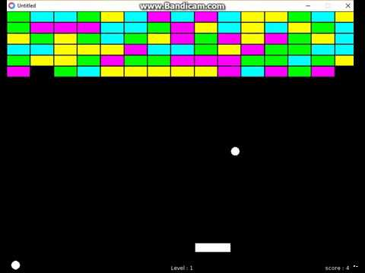

The concept
Thanks to a motion sensor (a PIR or an accelerometer) we detect the movement of the player, allowing him to move the racket of our brick-breaker game.

Slide 3
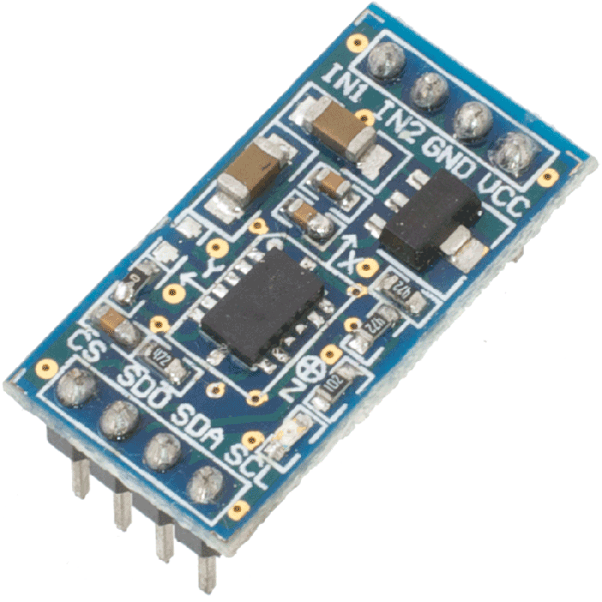
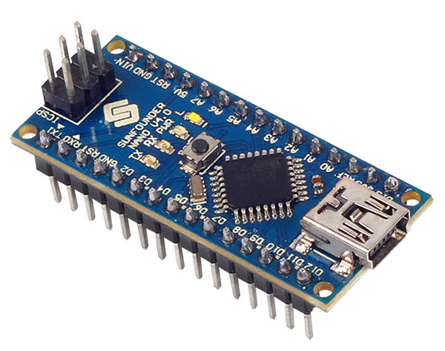



Technology used
The Component
One Arduino nano board
One MMA7455 accelerometer
Sofware
C (for the arduino)
C (for the game, using Unity engine)

Slide 4
Choosing the sensor
Initially
A PIR (Passive infrared sensor)
Rejected: Because infrared technology implied that detection might not be efficient under some environmental condition (ex: to much light in a room) and during our testing phase with this sensor we did not manage to set the PIR detection to our convinience. It resulted in an ineffective way to detect our player.
Final choice
An Accelerometer
Kept: Because it allowed us to still show motion sensing technology like we wanted at the start of our project and it freed us from the problematics of Infrared technology.

Slide 5
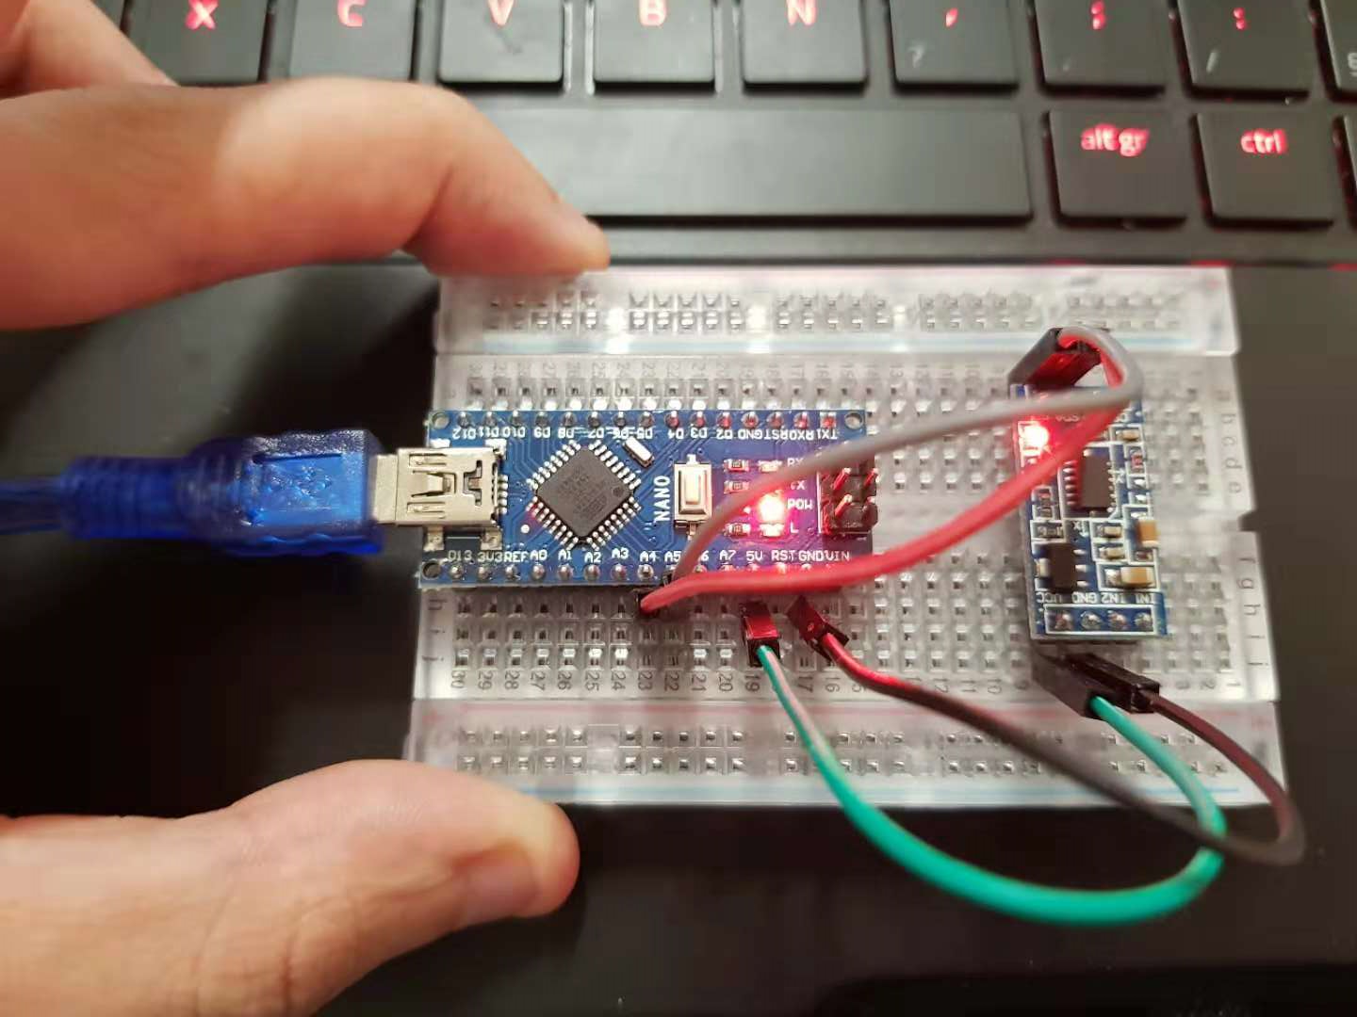
Result
With a really simple montage we are able make a “gamepad” which detects the movement of the player by tilting the pad on the left or the right.

Slide 6
Live Demo

Slide 7
Difficulties encountered
The final result of our project is far from what we hoped to accomplish and thus for three reasons:
We took to much time deciding which sensor we will use
Testing ours sensors was also much more time consuming than we intended
Communication between the Arduino board and Unity even if simple to make can be a big source of errors.

Slide 9
TJU-2018 Sensor Motion Sensing : Controlling a video game with motion sensing
Lucas kechouri 6218000236
Guenard arnaud 6218000232

